Slide 1
Healthcare Analytics for Disease Prediction Project

Slide 2

Analyze healthcare data to predict the likelihood of a disease.
Utilize machine learning algorithms for classification.
Provide insights for early intervention and prevention.

Slide 3
Module 1 | Data Collection and Preprocessing
Module 2 | Exploratory Data Analysis
Module 3 | Disease Prediction Model
Module 4 | Model Evaluation
Module 5 | Documentation

Slide 4
Module 1. Data Collection and Preprocessing
Data Sources:
- Collect relevant healthcare data from sources such as electronic health records (EHRs), medical databases, or public health datasets.
Data Cleaning:
- Handle missing values, outliers, and inconsistencies in the healthcare data.
- Standardize data formats and units.
Feature Engineering:
- Create features relevant to disease prediction, such as patient demographics, medical history, and diagnostic test results.

Slide 5
Module 2. Exploratory Data Analysis
Descriptive Statistics:
- Calculate descriptive statistics to understand the distribution of variables.
Data Visualization:
- Visualize relationships between different features using charts and graphs.
- Explore patterns and correlations in the data.

Slide 6
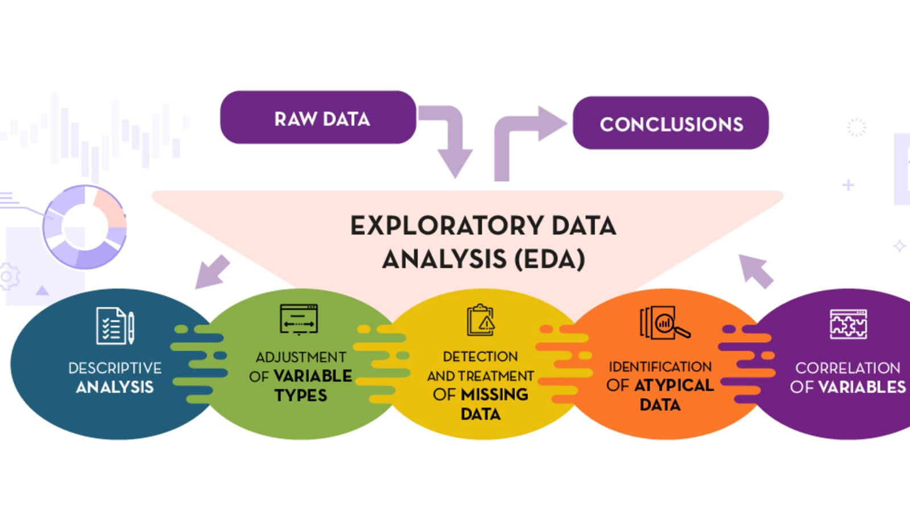

Slide 7
Module 3. Disease Prediction Model
Selection of Algorithms:
- Choose appropriate machine learning algorithms for disease prediction (e.g., logistic regression, decision trees, random forests, or deep learning models).
Target Variable Definition:
- Define the target variable based on the disease of interest (binary classification for presence/absence of the disease or multiclass for different disease categories).
Training Data Split:
- Split the dataset into training and testing sets to evaluate model performance.
Model Training:
- Train the selected model on the training dataset.
Hyperparameter Tuning:
- Optimize model hyperparameters to improve predictive performance.

Slide 8
Module 4. Model Evaluation
Performance Metrics:
- Evaluate the model using metrics such as accuracy, precision, recall, F1-score, and area under the Receiver Operating Characteristic (ROC) curve.
Confusion Matrix:
- Analyze the confusion matrix to understand true positives, true negatives, false positives, and false negatives.
Cross-Validation:
- Implement cross-validation to assess model stability and generalizability.

Slide 9
Module 5. Documentation
Code Documentation:
- Document the codebase, algorithms used, and data preprocessing steps.
Model Documentation:
- Provide documentation for the model architecture, hyperparameters, and training process.

Slide 10



